Slide 1
A Look at iOS ARKit 2.0
Augmented Reality Session

Slide 2

About Me
Raised in The Netherlands
4+ years at Neudesic
12+ years of coding experience
Coding is my hobby
Loves to help people
Mobile - Xamarin, React Native, Native
Desktop - WPF, UWP
Web - ASP .NET, Angular, NodeJS
Cloud - GCP, Azure

Slide 3
What is AR ?
Project Overview
Project Setup
Contents
Objects Recognition / Anchors
Transformations / Placement of 3D Objects
Accelerate / SIMD Framework
Use Cases
Q & A

Slide 4
What is AR ?

Slide 5
Augmenting Objects
Placing 3D objects into the real world
Tracking World
Coordinate System on top of world
Detecting Planes

Slide 6
W.I.P.
Lighting
Occlusion
Physics & Depth
CPU & Graphics Power
AR Glasses

Slide 7
Current Developments
ARKit 2.0
ARCore 1.5
Niantic
6D
Magic Leap
HoloLens – Windows 10

Slide 8

ARKit 2.0 Project Overview
Demo

Slide 9
Understanding World Tracking
Gravity
GravityAndHeading
Camera

Slide 10
ARKit fundamental building blocks
SCNView – A view that displays scenes with the addition of having a camera background to place the scenes on.
ARSession – An ARSCNView has an AR session associated with it. The ARSession processes the camera image and tracks the device’s motion
SCNScene - An instance represents a 3D scene and its contents, including lights, 3D-objects, cameras, and other attributes
SCNNode – A SCNNode is a node within the scene, nodes can be a parent of others nodes. A scene has 1 main rootNode where all others are children thereof.
ARWorldTrackingConfiguration – A configuration to setup the world tracking for an AR Session. The ARWorldTrackingConfiguration will be passed along to the session when run.

Slide 11
ARKit 2.0 Project Setup

Slide 12
Creating the Project
Create a new Xamarin.iOS Project
Set camera description in info.plist
Create a UIViewController
Create a ARSCNView and add it as a subview to the current View
Set ARWorldTrackingConfiguration to the Session
Set the DebugOptions: ShowWorldOrigin & ShowFeaturePoints
Start the World Tracking Configuration Session

Slide 13
Setup our first Node
Create a new geometric shape (e.g. SCNBox)
Set for the FirstMaterial a diffuse color (or texture)
Create a new SCNNode where the geometric object will live
Set on the SCNNode the Geometery property and the position of where it should be in the scene.
Create a new SCNScene
Set on the SCNScene RootNode the node that we just created
Finally set the scene on the SCNView Scene property
implement ARSessionDelegate – Related to the Anchors and whats in the world
Implement IARSCNViewDelegate – Related to the Nodes and whats in the scene

Slide 14
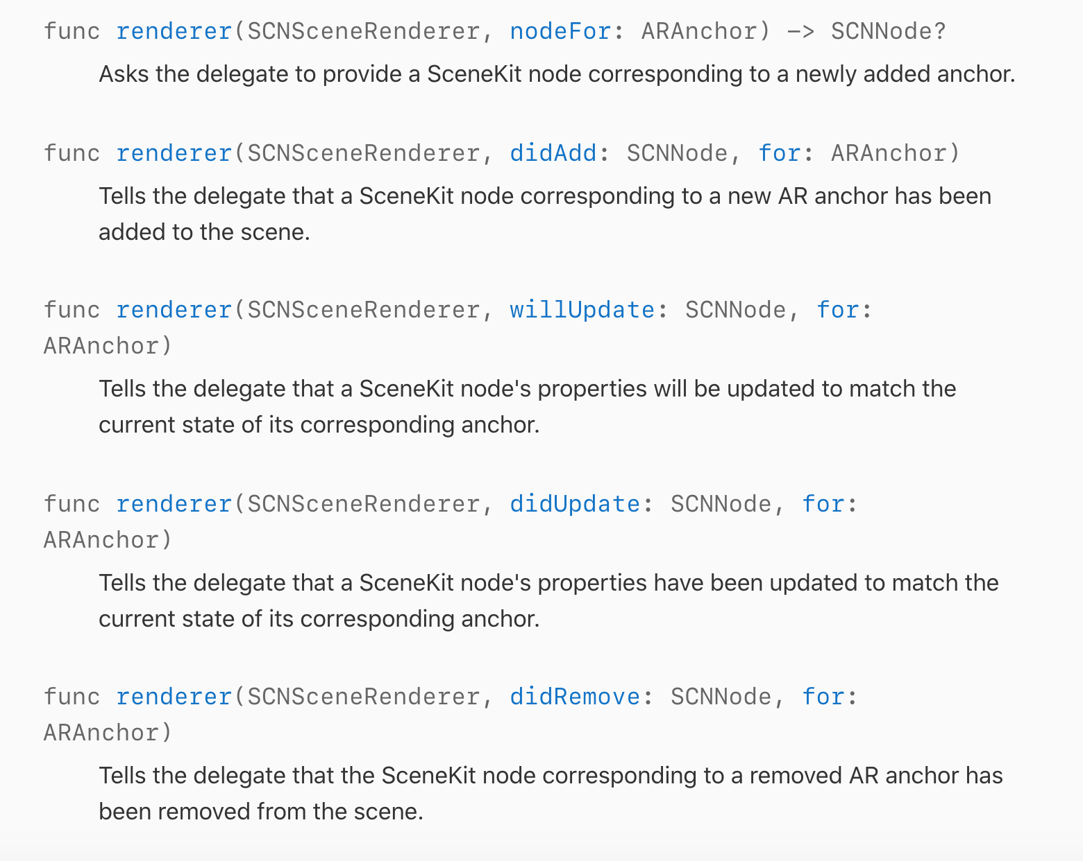
ARSCNViewDelegate
ARSCNViewDelegate gives you access to updates about the scene.

Slide 15
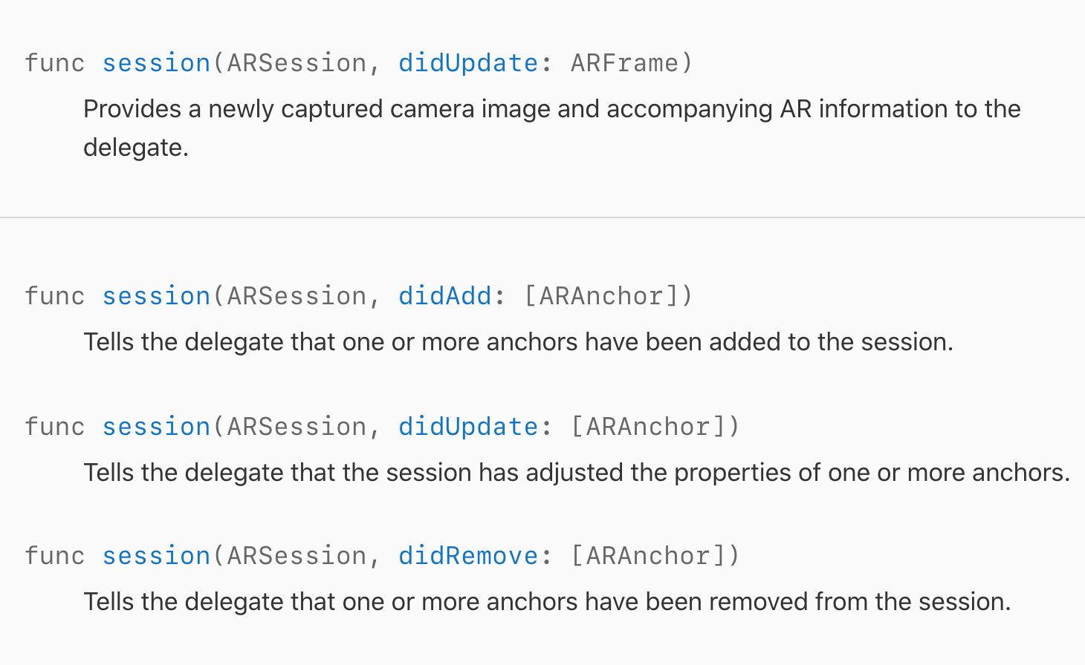
ARSessionDelegate
ARSessionDelegate gives you access to updates about the session that is running.

Slide 16
ARKit 2.0 Project Setup
Demo

Slide 17
Object Recognition

Slide 18
Recognition
Image Recognition
3D Object Recognition
Face Recognition
Plane Recognition

Slide 19
Anchors
A real-world position and orientation that can be used for placing objects in an AR scene.
ARPlaneAnchor
ARObjectAnchor
ARImageAnchor
ARFaceAnchor
Custom AR Anchor

Slide 20
Object Recognition
Demo

Slide 21
Transformations
/ Placement of Objects

Slide 22
What is a transformation ?
Transformation means changing some graphics into something else by applying rules.
Translation – translate its x, y, z coordinates
Rotation – rotation in 3 dimensions
Scaling – scaling up or down

Slide 23
Placement of 3D Objects
You can set the objects position by setting its Position property, which a 3DVector
To actually get a transformation going we need to do 3 steps:
1. Create an identity matrix 4x4
2. Set the required values on the matrix e.g. to translate set the tx, ty, tz values on the 4x4 matrix.
3. Now all we need to do is TransformMatrix = Translate * object.Transform
let transformMatrix = translationMatrix * rotationMatrix * scaleMatrix
let newTransform = transformMatrix * objectTransform

Slide 24
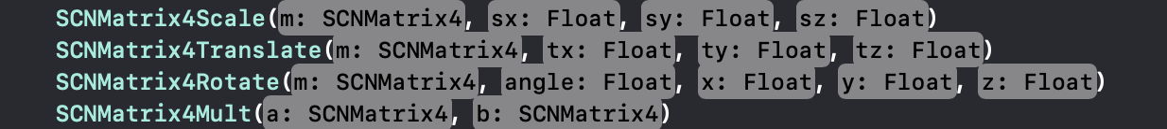
Ways to Translate / Rotate / Scale
Using the SCN methods provided
matrix_identity_float4x4
Using the SIMD framework
NOTE! Angles are in Radians unless otherwise specified

Slide 25
SIMD Framework
SIMD framework – For real parallel task, Getting multiple operations in one hit through the CPU.
SceneKit provides various SIMD method / properties to interacts with Nodes.

Slide 26
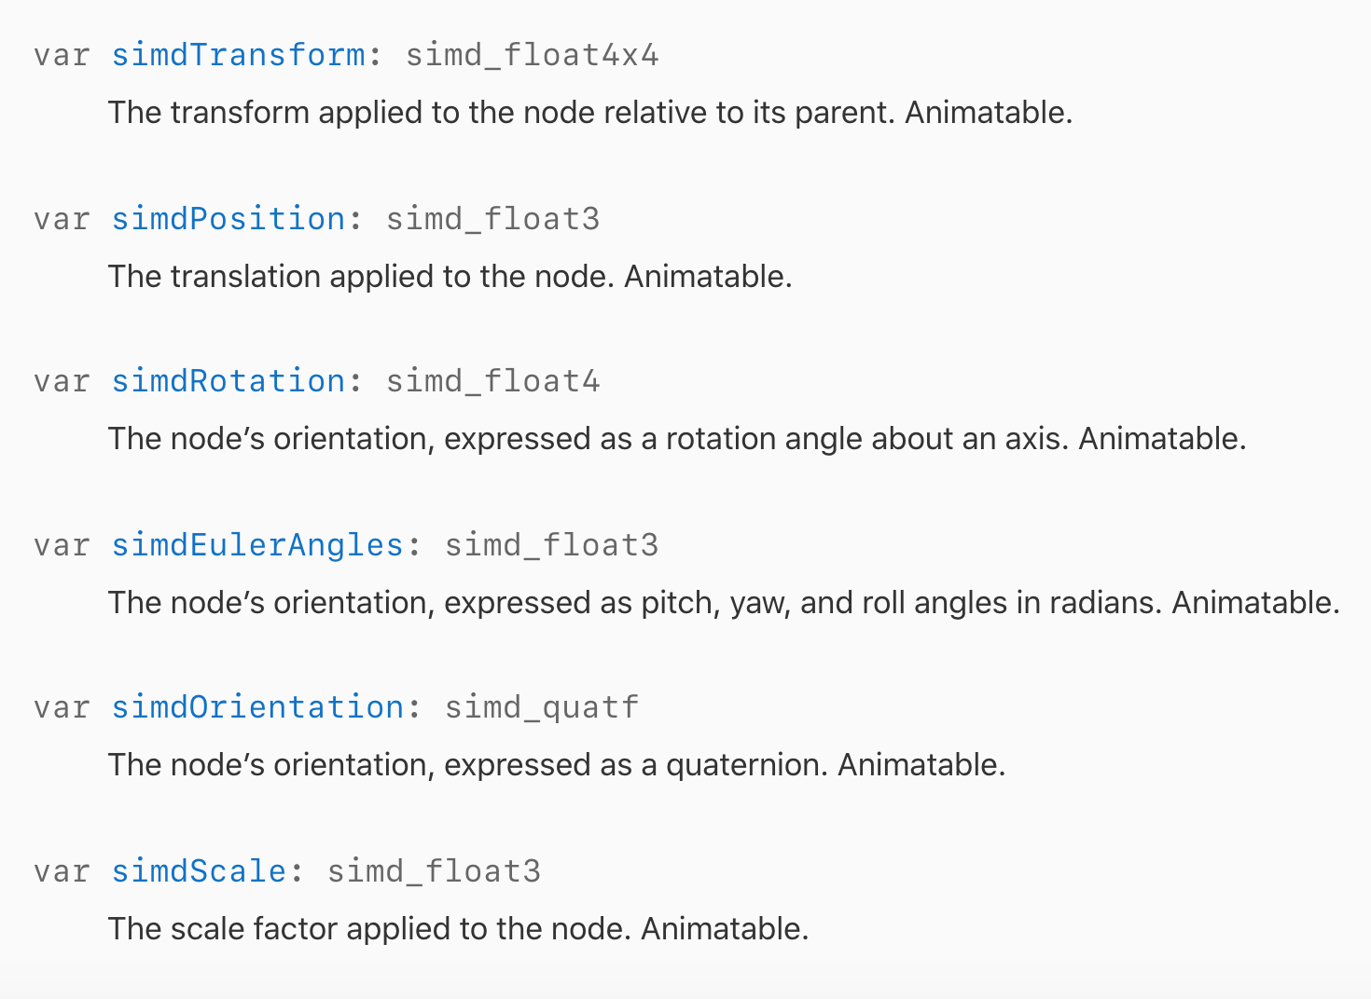
SIMD Framework Part 2

Slide 27
Transformations
/ Placement of Objects
Demo

Slide 28
Use Cases

Slide 29
Use Cases
Informational & Realism
Increasing a persons imagination by seeing it
Interacting with real world objects
Replacing real world object - future

Slide 30
Thank you!
Any questions?

